Slide 1
Economic Integration
Agreements between group of countries in a region to reduce and ultimately remove tariff and Non tariff barriers to the free flow of goods, services and factors of production between each other. By entering in to regional agreements countries aim to reduce trade barriers more rapidly than what can be achieved under WTO.

Slide 2
Three levels of economic integration
Global: trade liberalization by GATT or WTO
Regional: preferential treatment of member countries in the group
Bilateral: preferential treatment between two countries
Regional and bilateral agreements are against the MFN clause (normal trading relations), but allowed under WTO.

Slide 3
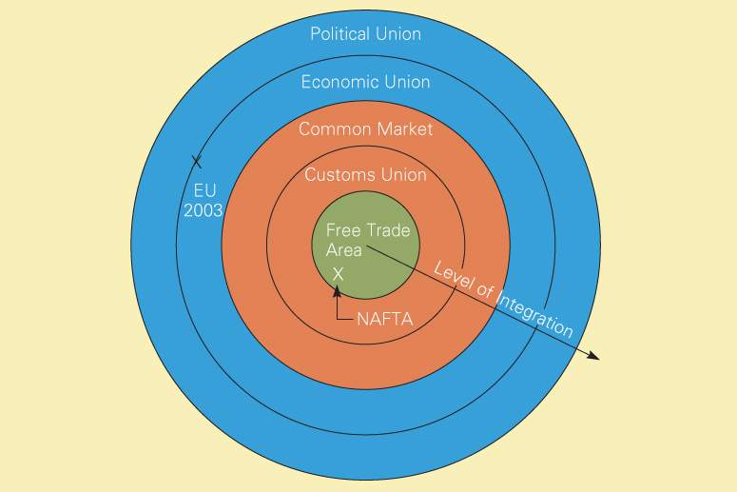
Levels of Economic Integration
Fig 8.1

Slide 4
Six stages (types) of economic integration
PTA (Preferential Trade Area)
Reduction of tariff on trade among members
FTA (free trade area):
no internal tariffs among members, but each country imposes its own external tariffs to the third country.
NAFTA (North America Free Trade Agreement
AFTA (ASEAN Free Trade Area)
EFTA (European Free Trade Area)
Customs union:
no internal tariffs and common external tariffs
Mercosur (Southern Common Market),
CACM (Central American Common Market)

Slide 5
Six stages (types) of economic integration
Common market:
free movement of products and factors (resources), which is customs union plus factor mobility
EU (European Union – previously EEC)
Economic union:
common market plus common currency
coordination of fiscal and monetary policy
EMU (Economic and Monetary Union)
Political Union
Central political system that coordinates the economic, social, and foreign policy of the member states

Slide 6
Economic effects of economic integration
Static effects: Short-term effects (shift of production)
Trade creation: production shifts to more efficient member countries from inefficient domestic or outside countries.
Trade diversion: production shift to inefficient member countries from more efficient outsiders.
Dynamic effects: Long-term effects
Cost reduction due to economies of scale
Cost reduction due to increased competition.

Slide 7
History of EU
Treaty of Paris (1951)
Formation of ECSC (European coal and steel community) by six countries
Treaty of Rome (1957)
Formation of EEC (European economic community), initially free trade area, becoming a customs union in 1967.
The Stockholm convention in 1960 created EFTA by seven countries to counteract EEC.

Slide 8
History of EU Continued
Single European Act of 1987
Creation of single market (Common market) effective on Jan. 1, 1993
Rename EEC by EU (15 members)
Treaty of Maastricht (1992)
Creation of an economic union, EMU (11 members)
Establishment of European Central Bank on July 1998
Introduction of a common currency, euro on Jan. 1, 1999
Circulation of euro on Jan 1, 2002

Slide 9
Organization of EU
European Commission:
administrative body of 20 members
Initiate proposals
Guardian of the treaties
Implementing policies
European Parliament
626 members elected according to population distribution
Legislative body, but final decision by Council of Ministers
Control over budget and supervision of the Commission

Slide 10
Organization of EU Continued
European Council and Council of Ministers
European Council: summit meeting of state heads, providing guidelines
Council of Ministers
25 different councils (agriculture, transport, etc.)
Final say on legislations
Different votes allocated to individual countries (according to population)
Unanimity or qualified majority voting required depending on issues.
Others
Court of Justice, Court of Auditors, sub-committees

Slide 11
Special focus of EU
CAP(common Agricultural policy) aims to better production, certainty in food supplies, quality of life and stabilized market.
Energy policy- increase competition in the internal market, encourage investment and boost interconnections between electricity grids; diversify energy resources with better systems to respond to a crisis;
Infrastructure development.
Balanced regional growth.
Environmental protective measures.

Slide 12
EMU (Economic & Monetary Union)
Common currency (Euro) area for 11 members
Euro became the official currency unit on Jan. 1, 1999.
Euro will be in circulation from Jan. 1, 2001
U.K, Denmark and Sweden opted out.
Greece was not qualified.
European Monetary System in 1979 ➔ European Monetary Institute in 1994 ➔ European Central Bank in July 1, 1998
Convergence criteria
Inflation (no more than 1.5% above the 3 lowest ave.)
Long-term interest rate (no more than 2% above the 3 best ave.)
Budget deficit: no more than 3% of GDP
Public debt: no more than 60% of GDP

Slide 13
Remaining Issues of EU
Further elimination of barriers to common market
Compatible standards and specifications
No barriers to market access
Coordination of VAT and other taxes
Expansion
European Economic Area: extension of customs union privileges to EFTA member countries (Norway, Iceland and Liechtenstein accepted. Switzerland voted not to join)
Special agreements with Turkey and others
Expansion to central and eastern European countries
Fast-track applicants
Other applicants

Slide 14
NAFTA
North America Free trade Agreement
Free trade area among the U.S., Canada and Mexico
The largest trading bloc in terms of GNP
A good example of trade diversion (production shifted from Asia to Mexico)
History
Automotive products Trade Agreement (1965) between the U.S. and Canada
Canada-U.S. Free Trade Agreement (1989)
NAFTA (1994)

Slide 15
Provisions of NAFTA
Elimination of tariffs
Most tariffs will be eliminated by 2004
The remaining by 2008
Elimination of nontariff barriers
Harmonization of trade rules (subsidies, antidumping, safety standards)
Liberalization of capital movement (FDI)
Protection of intellectual properties
Dispute settlement
Provisions on labor and environmental standards

Slide 16
Economic Effects of NAFTA
Trade
Trade among members increased faster than trade with the rest of world
Investment
Mexico is the main beneficiary (FDI not only from the U.S. and Canada, but also from other countries)
Employment
Difficult to measure because of too many confounding variables
Overall employment effect in the area including the U.S. has been positive

Slide 17
Issues related to NAFTA
Rule of origin and local content
Rule of origin: products must originate from North America to get preferential treatment.
Local content: the percentage of value of a product that must be from North America to be considered as North American origin
Currently 50% for most products and 62.5% for autos. Political pressure to increase this percentage
Expansion of membership
Potential entry by Chile, and some central and south American countries
FTAA (Free Trade Area of America) proposal in 2001

Slide 18
Arguments against NAFTA:
- mass exodus of jobs from the US and Canda (Perot’s “Sucking Sound”)
- Expose Mexican firms to highly efficient Canadian and American firms.
- Painful Economic Restructuring and Unemployment in Mexico
- Loss of National Sovereignty

Slide 19
Other Regional Trade Blocs
ASEAN and AFTA
Originated in 1967
Formation of AFTA in 1993
Reduction of intrazone tariffs to a maximum of 5% by 2008 (by 2004 for some countries)
Mercosur (Southern Common Market)
Formed in 1991 by Brazil, Argentina, Paraguay and Uruguay.
Aim for a customs union, but not yet

Slide 20
Other Regional Trade Blocs
Others
Andean group (Andean Common Market)
ALADI (Latin American Integration Association)
CARICOM (Caribbean Community and Common Market)
CACM (Central American Common Market)

Slide 21
APEC
Asia Pacific Economic cooperation
Formed in 1989 to promote trade and investment
21 member countries that border the Pacific Rim
APEC is not a trading bloc
For trade liberalization and against protectionism
Prefer open regionalism over closed regionalism
Goal: Free and open trade
by 2010 for the industrialized countries
by 2020 for the rest of the members

Slide 22

Organisation of UNCTAD

It is established as a permanent organ of General Assembly of theUnited Nation.

It has a permanent organ called ³Trade and Development Board´ asthe main executive body.

The plenary session of the Conference meets twice annually which iscomposed of 55 members, elected by the conference from among itsmembers on the basis of equitable geographical distribution.
UNCTAD: 1964
UNITED NATIONS CONFERENCE ON TRADE AND CONFERENCE ON TRADE AND DEVELOPMENT

Slide 23
Organisation of UNCTAD
Organisation of UNCTAD

It is established as a permanent organ of General Assembly of theUnited Nation.

It has a permanent organ called ³Trade and Development Board´ asthe main executive body.

The plenary session of the Conference meets twice annually which iscomposed of 55 members, elected by the conference from among itsmembers on the basis of equitable geographical distribution.
It is established as a permanent organ of General Assembly of the United Nation.
It has a permanent organ called Trade and Development Board´ as the main executive body.
The plenary session of the Conference meets twice annually which is composed of 55 members, elected by the conference from among its members on the basis of equitable geographical distribution.

Slide 24
UNCTAD
Trust and credibility among developing countries
Independent research
BUT
Only a political role (no “teeth”)
Limited human and financial resources

Slide 25
UNCTAD ideas
Influenced by development theories of center/periphery
Deterioration of the terms of trade
Unfair and asymmetric international economic relations
Need for international policies and rules to address these asymmetries: Special and differential treatment (trade preferences, exceptions, longer periods of adjustment…)
Non-tariff barriers
External debt : sustainability, reduction formulas
Trade in services
Positive agenda in trade negotiations
Policy space
No one size fits all

